Slide 1




Tools and Techniques for
Quality Management
Unit: 3
Subject Name – Total Quality Management
Faculty Name – Mr. Minhaj Nezami
Assistant Professor
Department - IT
Course – B. Tech 8th Semester

Slide 2



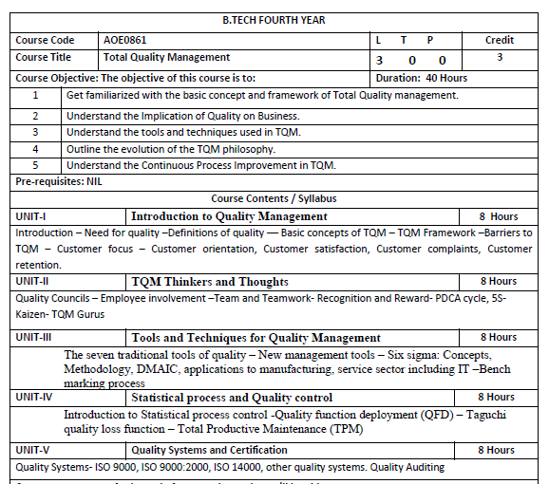

Slide 3
CONTENTS
Course objectives
Course outcomes
Program Outcome
CO-PO Mapping
Program Specific outcome
CO-PSO Mapping
Program Educational Objectives
Recap and precap
Syllabus of Unit 3
Recap of team
Objective of histogram
Histogram
Recap of histogram
Objective of check sheet
Check sheet

Slide 4
CONTENTS
Recap of check sheet
Objective of Ishikawa diagram
Ishikawa diagram
Recap of Ishikawa diagram
Objective of Pareto chart
Pareto chart
Recap of Pareto chart
Objective of Scatter diagram
Scatter diagram
Recap of Scatter diagram
Objective of Control chart
Control chart
Recap of Control chart

Slide 5
CONTENTS
Objective of Flow chart
Flow chart
New Management Tools
Six Sigma
Benchmarking
Video links
Daily quiz
Weekly assignments
MCQs
Old question papers
Expected questions for university exam
Summary

Slide 6
COURSE OBJECTIVES
AOE0861.1 | To learn about common term Quality Concepts
AOE0861.2 | To know TQM principle
AOE0861.3 | To understand the importance of different chart like P-charts and C-charts
AOE0861.4 | To know new term PDCE cycle, 5S,Kaizen
AOE0861.5 | To be aware about different ISO standards and JIT

Slide 7




UNIT OBJECTIVE
To learn about control charts

Slide 8
COURSE OUTCOMES
AOE0861.1 | Define the Quality Concepts and Manufacturing Quality
AOE0861.2 | Conceptualize the term Quality Management and relate to this various TQM Principles
AOE0861.3 | Analyze the different Tools and Techniques and Control Charts
AOE0861.4 | Distinguish between Defects Diagnosis and Prevention term
AOE0861.5 | Coordinate IS0 and its concept to Quality Management

Slide 9
PROGRAM OUTCOME
1. Engineering knowledge
2. Problem analysis
3. Design/development of solutions
4. Conduct investigations of complex problems
5. Modern tool usage
6. The engineer and society
7. Environment and sustainability
8. Ethics
9. Individual and team work
10. Communication
11. Project management and finance
12. Life-long learning

Slide 10
CO-PO Mapping
CO | PO1 | PO2 | PO3 | PO4 | PO5 | PO6 | PO7 | PO8 | PO9 | PO10 | PO11 | PO12
AOE0861.1 | 3 | 3 | 2 | 2 | 1 | 2 | 2 | 1 | 1 | 1 | 2 | 3
AOE0861.2 | 3 | 3 | 3 | 3 | 2 | 2 | 2 | 1 | 1 | 1 | 2 | 3
AOE0861.3 | 3 | 3 | 2 | 3 | 3 | 2 | 2 | 1 | 2 | 1 | 2 | 3
AOE0861.4 | 3 | 2 | 3 | 2 | 2 | 2 | 2 | 1 | 2 | 1 | 3 | 3
AOE0861.5 | 3 | 2 | 3 | 2 | 2 | 2 | 2 | 1 | 2 | 1 | 2 | 3
Avg | 3 | 2.6 | 2.6 | 2.4 | 2 | 2 | 2 | 1 | 1.6 | 1 | 2.2 | 3

Slide 11
PROGRAM SPECIFIC OUTCOME
On successful completion of graduation degree, The computer Science & Engineering graduates will be able to:
PSO1: identify, analyze real world problems and design their ethical solutions using artificial intelligence, robotics, virtual/augmented reality, data analytics, block chain technology, and cloud computing.
PSO2: design and develop the hardware sensor devices and related interfacing software systems for solving complex engineering problems.
PSO 3: understand inter-disciplinary computing techniques and to apply them in the design of advanced computing.
PSO 4: conduct investigation of complex problem with the help of technical, managerial, leadership qualities, and modern engineering tools provided by industry sponsored laboratories.

Slide 12
CO-PSO Mapping
CO | PSO1 | PSO2 | PSO3
AOE0861.1 | 3 | 2 | 3
AOE0861.2 | 3 | 2 | 2
AOE0861.3 | 3 | 2 | 3
AOE0861.4 | 3 | 3 | 3
AOE0861.5 | 3 | 2 | 3
Avg | 3 | 2.2 | 2.8

Slide 13
Program Educational Objectives
PEO 1: To have an excellent scientific and engineering breadth so as to comprehend, analyze, design and provide sustainable solutions for real-life problems using state-of-the-art technologies.
PEO 2: To have a successful career in industries, to pursue higher studies or to support entrepreneurial endeavors and to face the global challenges.
PEO 3: To have an effective communication skills, professional attitude, ethical values and a desire to learn specific knowledge in emerging trends, technologies for research, innovation and product development and contribution to society.
PEO 4: To have life-long learning for up-skilling and re-skilling for successful professional career as engineer, scientist, entrepreneur and bureaucrat for betterment of society.

Slide 14
RECAP AND PRECAP
RECAP
1. What is TQM?
2. Modern approach
3. Principles
PRECAP
1. Quality control tools
2. Histogram
3. Check sheet
4. Ishikawa diagram
5. Pareto chart

Slide 15
SYLLABUS OF UNIT 3
Tools and Techniques for Quality Management
The seven traditional tools of quality – New management tools – Six sigma: Concepts, Methodology, DMAIC, applications to manufacturing, service sector including IT –Bench marking process

Slide 16
Recap of Team
The main advantage is that a team brings together different people with diverse skills and allows them to make something that nobody could do alone.

Slide 17
Objective of Histogram
Bar chart pictures of data that shows patterns that fall within typical process conditions

Slide 18
Introduction (CO3)
Many organizations use quality tools to help monitor and manage their quality initiatives.
There are several types of tools that can be used. However, there are seven management tools for quality control that are the most common.
Different tools are used for different problem-solving opportunities, and many of the tools can be used in different ways.
The trick is to become familiar and comfortable with all of these quality tools so you can pull the appropriate one out of your toolbox when there is a problem that needs to be solved

Slide 19
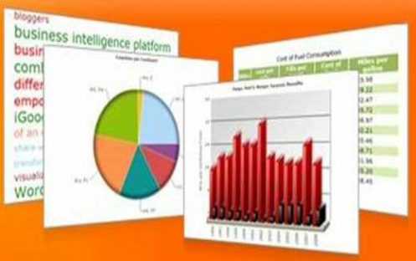
Tools For Quality Control (CO3)

Slide 20
HISTOGRAMS (CO3)
Histograms are bar chart pictures of data that shows patterns that fall within typical process conditions.
Changes in a process should trigger new collection of data.
A minimum of 50-75 data points should be gathered to ensure an adequate number of data points have been collected.
The patterns that are detected demonstrate an analysis that helps understand variation.
In this example, it shows that the receptionist received the most phone calls about contribution statements for that period.

Slide 21
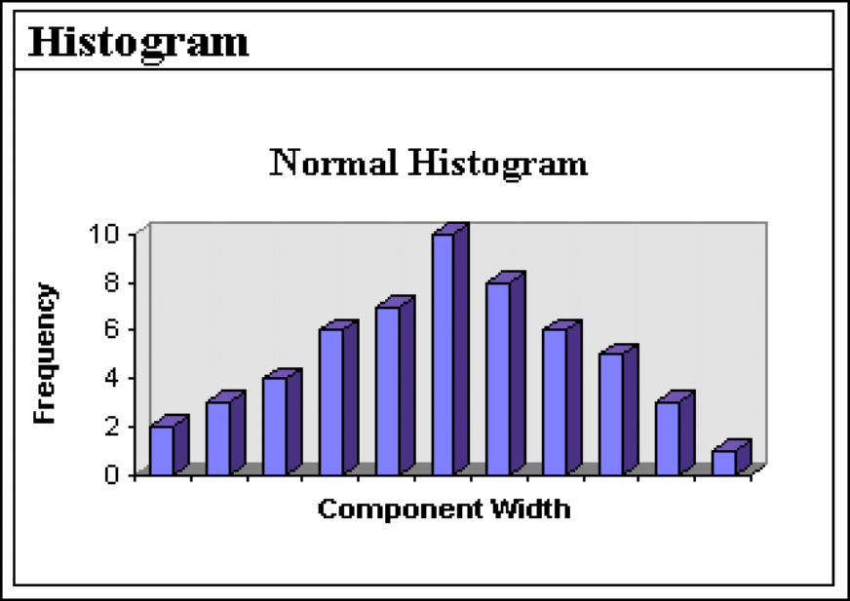
HISTOGRAMS (CO3)

Slide 22
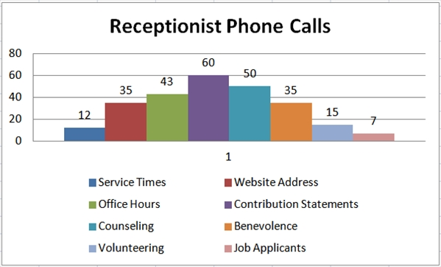
HISTOGRAMS (CO3)

Slide 23
Recap of Histogram
The patterns that are detected demonstrate an analysis that helps understand variation

Slide 24
Objective of check sheet
Check sheet is a basic quality tool that is used to collect data

Slide 25
Check sheet (CO3)
A check sheet is a basic quality tool that is used to collect data. A check sheet might be used to track the number of times a certain incident happens.
As an example, a human resource department may track the number of questions by employees, per category, per day.
In this particular check sheet the tool shows the total number of questions received by the human resources department.
This information helps that department identify opportunities to proactively share information with employees in an effort to reduce the numbers of questions asked.

Slide 26
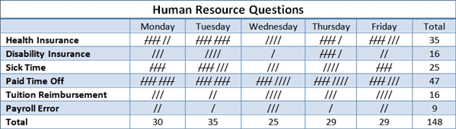
Check sheet (CO3)

Slide 27
Recap of check sheet
A check sheet might be used to track the number of times a certain incident happens.

Slide 28
Objective of Ishikawa
Shows the many possible causes of a problem

Slide 29
Ishikawa diagram (CO3)
Ishikawa diagram also known as a ,cause and effect diagram, fish-bone diagram shows the many possible causes of a problem.
To use this tool, you need to first identify the problem you are trying to solve and simply write it in the box (head of the fish) to the right.
Next, you will list the major causes of the problem on the spine of the fish.
Causes are typically separated into categories of people, process, materials and equipment.
Causes are then identified through brainstorming with a group familiar with the problem.
Once all of the possible causes are identified, they can be used to develop an improvement plan to help resolve the identified problem.

Slide 30
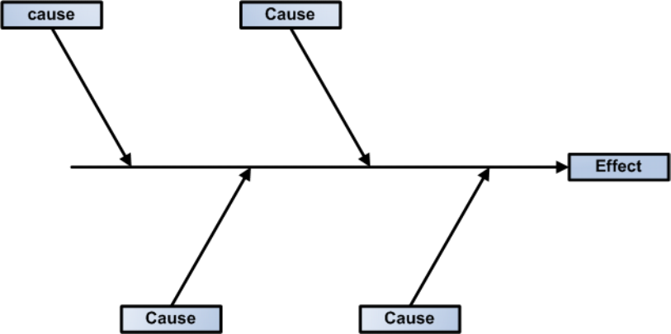
Ishikawa diagram (CO3)

Slide 31
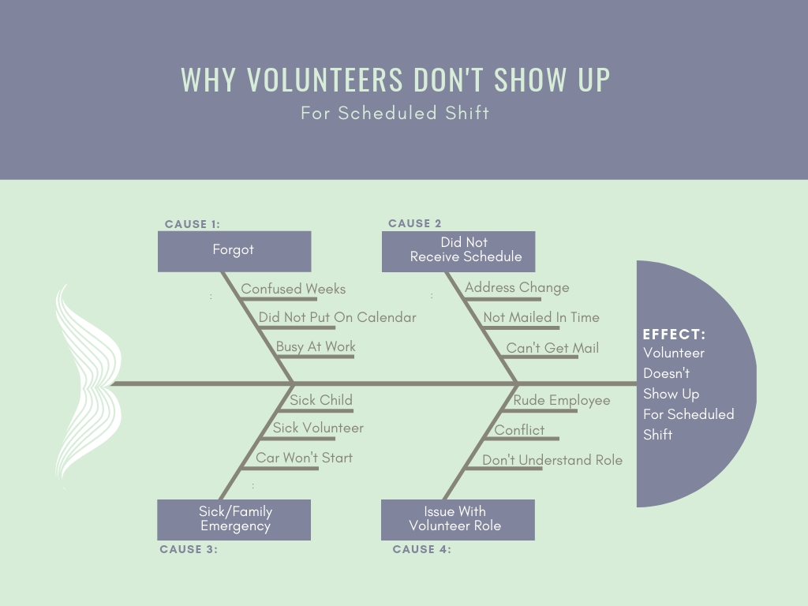
Ishikawa diagram (CO3)

Slide 32
Recap of Ishikawa
Once all of the possible causes are identified, they can be used to develop an improvement plan to help resolve the identified problem.

Slide 33
Objective of Pareto chart
Showing how many results were generated by the type or category of the identified cause

Slide 34
Pareto chart (CO3)
The Pareto Chart is a histogram ordered by the frequency of result occurrences, showing how many results were generated by the type or category of the identified cause.
The relative position of the occurrences is used to guide corrective actions
The corrective actions must initially focus on the problems that are causing the majority of defects.
A Pareto chart is a bar graph of data showing the largest number of frequencies to the smallest
In this example, we are looking at the number of product defects in each of the listed categories.
When you look at the number of defects from the largest to the smallest occurrences, it is easy to see how to prioritize improvements efforts.
The most significant problems stand out and can be targeted first

Slide 35
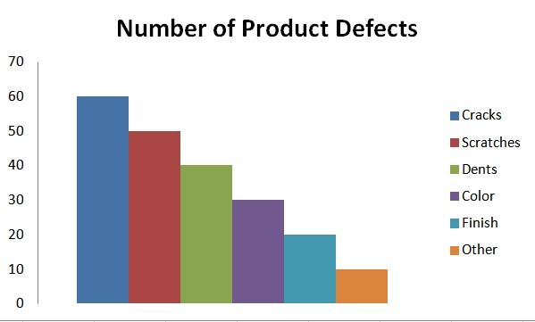
Pareto chart (CO3)

Slide 36
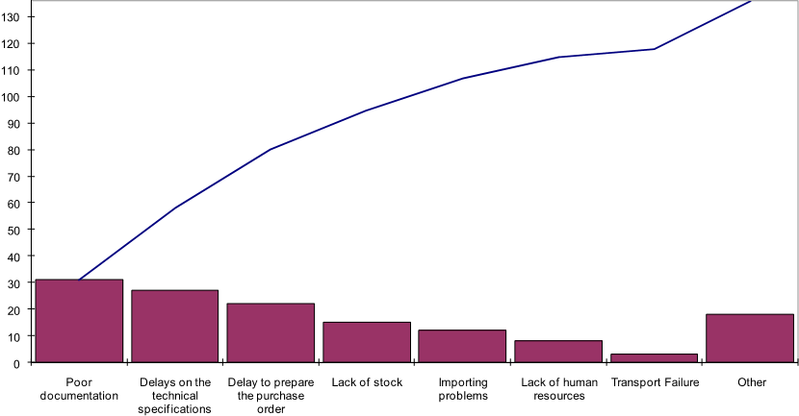
Pareto chart (CO3)

Slide 37
Recap of Pareto chart
A Pareto chart is a bar graph of data showing the largest number of frequencies to the smallest

Slide 38
Objective of scatter diagram
Show the relationship between variables through graph. Variables often represent possible causes and effect

Slide 39
Scatter diagram (CO3)
Scatter diagrams are graphs that show the relationship between variables. Variables often represent possible causes and effect.
As an example, a scatter diagram might show the relationship between how satisfied volunteers are that attend orientation training.
The diagram shows the relationship between volunteer satisfaction scores and volunteer orientation training.
Scatter Diagrams are used to study and identify the possible relationship between the changes observed in two different sets of variables

Slide 40
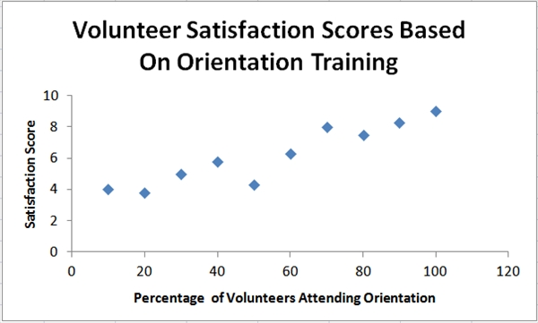
Scatter diagram (CO3)

Slide 41
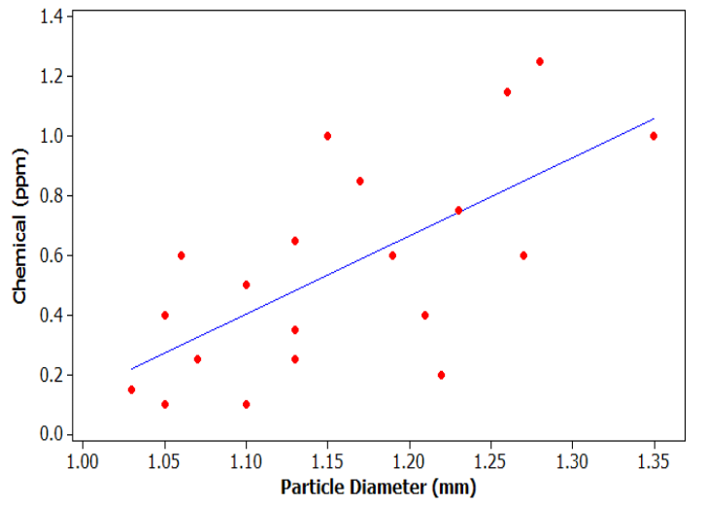
Scatter diagram (CO3)

Slide 42
Recap of Scatter diagram
Scatter Diagrams are used to study and identify the possible relationship between the changes observed in two different sets of variables

Slide 43
Objective of control chart
To plot data points over time and give a picture of the movement of that data.

Slide 44
Control chart (CO3)
Control charts or run charts are used to plot data points over time and give a picture of the movement of that data.
These charts demonstrate when data is consistent or when there are high or low outliers in the occurrences of data.
Control charts present the results of a process over time
They are used to determine if the process is under control
They are used to monitor any type of variable output

Slide 45
Control chart (CO3)
It focuses on monitoring performance over time by looking at the variation in data points. And it distinguishes between common cause and special cause variations. The Dow Jones Industrial Average is a good example of a control chart.
The control chart is a graph used to study how a process changes over time. Data are plotted in time order. A control chart always has a central line for the average, an upper line for the upper control limit, and a lower line for the lower control limit.
These lines are determined from historical data. By comparing current data to these lines, you can draw conclusions about whether the process variation is consistent (in control) or is unpredictable (out of control, affected by special causes of variation).

Slide 46
Control chart (CO3)
Control charts are at the heart of statistical process control (SPC). So maybe we should start with answering what a process is. A process is simply what we do. It can be filling out an expense report, checking a person into a hospital, driving to work, filling a prescription, etc.
All these processes generate an output - either a product or service. In addition, the processes generate data. SPC is simply taking that data the process generates and using it to control and improve the process.

Slide 47
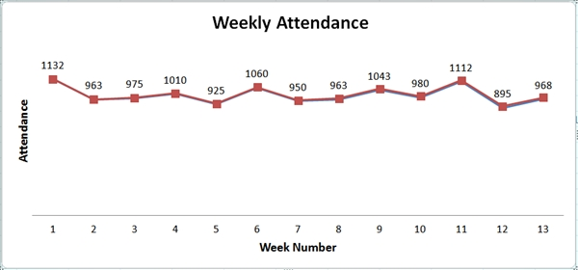
Control chart (CO3)

Slide 48
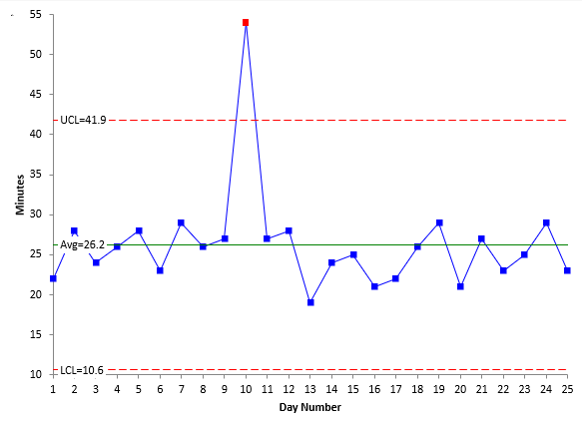
Control chart (CO3)

Slide 49
Control chart (CO3)
Control charts are at the heart of statistical process control (SPC). So maybe we should start with answering what a process is

Slide 50
Objective of Flow chart
Depicts how several elements interact with each other

Slide 51
Flow chart (CO3)
A flowchart is any chart that depicts how several elements interact with each other
Flowcharts are also used to document work process flows.
This tool is used when trying to determine where the bottlenecks or breakdowns are in work processes.
Flow-charting the steps of a process provides a picture of what the process looks like and can shed light on issues within the process.
Flowcharts are also used to show changes in a process when improvements are made or to show a new workflow process.
This example provides a picture so those checking children in will know the steps each takes depending on whether it is their first time or a child who has been there before.

Slide 52
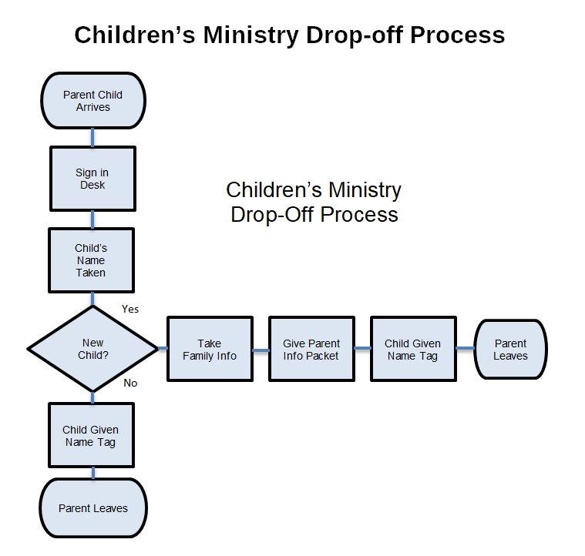
Flow chart (CO3)

Slide 53
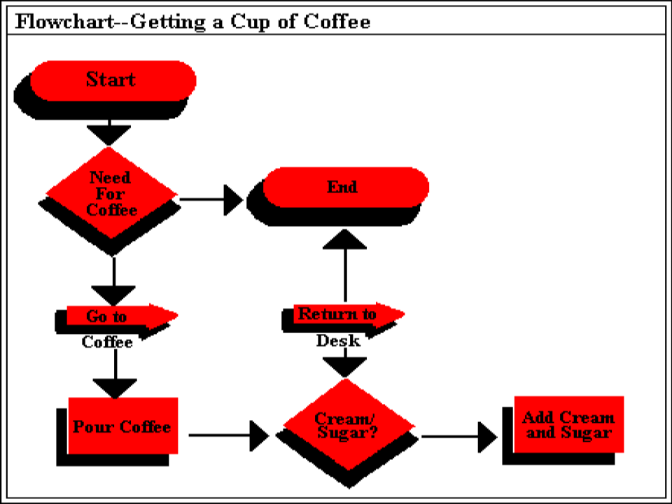
Flow chart (CO3)

Slide 54
New Management Tools
1. Affinity diagram: organizes a large number of ideas into their natural relationships.
2. Inter Relations diagram: Shows cause-and-effect relationships and helps you analyze the natural links between different aspects of a complex situation.

Slide 55
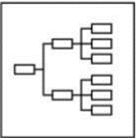
New Management Tools
3. Tree diagram: breaks down broad categories into finer and finer levels of detail, helping you move your thinking step by step from generalities to specifics.

Slide 56
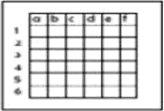
New Management Tools
4. Matrix diagram: shows the relationship between two, three or four groups of information and can give information about the relationship, such as its strength, the roles played by various individuals, or measurements.

Slide 57
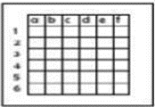
New Management Tools
5. Matrix data analysis: a complex mathematical technique for analyzing matrices, often replaced in this list by the similar prioritization matrix. One of the most rigorous, careful and time-consuming of decision-making tools, a prioritization matrix is an L-shaped matrix that uses pair wise comparisons of a list of options to a set of criteria in order to choose the best option(s).

Slide 58
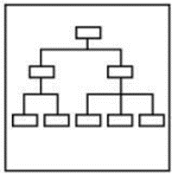
New Management Tools
6. Arrow diagram: shows the required order of tasks in a project or process, the best schedule for the entire project, and potential scheduling and resource problems and their solutions

Slide 59
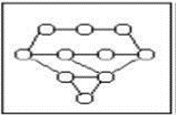
New Management Tools
7.Process decision program chart (PDPC): systematically identifies what might go wrong in a plan under development.

Slide 60
SIX SIGMA
SIX SIGMA
This is quality improvement initiatives which include – Clear focus on achieving measurable and quantifiable financial returns from any project. etc. to lead and implement the Six Sigma approach.
Assumptions and guesswork:
At Motorola University, we think about Six Sigma at three different levels:
As a metric
As a methodology
As a management system
Essentially, Six Sigma is all three at the same time.

Slide 61
SIX SIGMA
Six Sigma as a Metric
The term "Sigma" is often used as a scale for levels of "goodness" or quality. Using this scale,"Six Sigma" equates to 3.4 Defects Per Million Opportunities (DPMO). Six Sigma started as a defect reduction effort in manufacturing and then applied to other business processes for the same purpose. Taking the 1.5 sigma shift into account, short-term sigma levels correspond to the following long-term DPMO values (one-sided):
One Sigma = 690,000 DPMO => efficiency 31%
Two Sigma = 308,000 DPMO =>efficiency 69.2%
Three Sigma = 66,800 DPMO => efficiency 93.32%
Four Sigma =6,210 DPMO => efficiency 99.379%
Five Sigma = 230 DPMO => efficiency 99.977%
Six Sigma = 3.4 DPMO => efficiency 99.9997%

Slide 62
SIX SIGMA
Six Sigma as a Methodology
As Six Sigma has evolved, there has been less emphasis on the literal definition of 3.4 DPMO, or counting defects in products and processes. Six Sigma is a business improvement methodology that focuses an organization on:
Understanding and managing customer requirements
Aligning key business processes to achieve those requirements
Utilizing rigorous data analysis to minimize variation in those processes
Driving rapid and sustainable improvement to business processes

Slide 63
SIX SIGMA
At the heart of the methodology is the DMAIC model for process improvement. DMAIC is
commonly used by Six Sigma project teams and is an acronym for:
DMAIC - The basic methodology consists of the following five steps:
Define process improvement goals that are consistent with customer demands and the enterprise strategy.
Measure key aspects of the current process and collect relevant data.
Analyze the data to verify cause-and-effect relationships. Determine what the
relationships are, and attempt to ensure that all factors have been considered.
Improve or optimize the process based upon data analysis using techniques like Design of Experiments.
Control to ensure that any deviations from target are corrected before they result in defects. Set up pilot runs to establish process capability, move on to production, set up control mechanisms and continuously monitor the process.

Slide 64

SIX SIGMA
DMADV
The basic methodology consists of the following five steps:
Define design goals that are consistent with customer demands and the enterprise strategy.
Measure and identify CTQs (characteristics that are Critical To Quality), product capabilities, production process capability, and risks.
Analyze to develop and design alternatives, create a high-level design and evaluate design capability to select the best design.
Design details, optimize the design, and plan for design verification. This phase may require simulations.
Verify the design, set up pilot runs, implement the production process and hand it over to the process owners.

Slide 65
SIX SIGMA
Implementation roles –
One of the key innovations of Six Sigma is the professionalizing of quality management functions. Prior to Six Sigma, quality management in practice was largely relegated to the production floor and to statisticians in a separate quality department. Six Sigma borrows martial arts ranking terminology to define a hierarchy (and career path) that cuts across all business functions and a promotion path straight into the executive suite.

Slide 66
BENCHMARKING
BENCHMARKING
"Benchmarking: A continuous, systematic process of evaluating and comparing the capability of one organization with others normally recognized as industry leaders, for insights for optimizing the organizations processes."
Benchmarking is the process of comparing the cost, time or quality of what one organization does against what another organization does. The result is often a business case for making changes in order to make improvements. The systematic process of comparing an organization’s products, services and practices against those of competitor organizations or other industry leaders to determine what it is they do that allows them to achieve high levels of performance. (Society for Human Resources Management)

Slide 67
BENCHMARKING
Advantages of benchmarking
Benchmarking is a powerful management tool because it overcomes "paradigm blindness." Benchmarking opens organizations to new methods, ideas and tools to improve their
effectiveness.
It helps crack through resistance to change by demonstrating other methods.
Allows employees to visualize the improvement which can be a strong motivator for change.
Helps to identify weak areas and indicates what needs to be done to improve.

Slide 68
BENCHMARKING

Slide 69
BENCHMARKING
THE BENCHMARKING PROCESS
The formal 10-step benchmarking process is shown in outline below:
1. PLANNING
The essential steps are those of any plan development: what, who and how. Every function of an organization has or delivers a product or output. Benchmarking is appropriate for any output of a process or function, whether it is a physical good, an order, a Shipment, an invoice, a service or a report.

Slide 70
BENCHMARKING
To whom or what will we compare?
Business-to-business, direct competitors are certainly prime candidates to benchmark, but they are not the only targets. Benchmarking must be conducted against the best companies and business functions regardless of where they exist.
How will the data be collected?
There is no one way to conduct benchmarking investigations.
There is an infinite variety of ways to obtain required data – and most of the data you will need are readily and publicly available.
Recognize that benchmarking is a process not only of deriving quantifiable goals and targets, but more importantly, it is the process of investigating and documenting the best industry practices, which can help you achieve goals and targets.

Slide 71
BENCHMARKING
2. ANALYSIS
The analysis phase must involve a careful understanding of your current process and practices, as well as those of the organizations being benchmarked. What is desired is an understanding of internal performance on which to assess strengths and weaknesses.

Slide 72
BENCHMARKING
3. INTEGRATION
Integration is the process of using benchmark findings to set operational targets for change. It involves careful planning to incorporate new practices in the operation and to ensure benchmark findings are incorporated in all formal planning processes.
Steps include:
Gain operational and management acceptance of benchmark findings. Clearly and convincingly demonstrate findings as correct and based on substantive data. Develop action plans.
Communicate findings to all organizational levels to obtain support, commitment and ownership.

Slide 73
BENCHMARKING
4. ACTION
Convert benchmark findings, and operational principles based on them, to specific actions to be taken. Put in place a periodic measurement and assessment of achievement. Use the creative talents of the people who actually perform work tasks to determine how the findings can be incorporated into the work processes. Any plan for change also should contain milestones for updating the benchmark findings, and an ongoing reporting mechanism. Progress toward benchmark findings must be reported to all employees.
5. Maturity: Maturity will be reached when best industry practices are incorporated in all business processes, thus ensuring superiority. Tests for superiority: If the now-changed process were to be made available to others, would a knowledgeable business person prefer it?

Slide 74
BENCHMARKING
Do other organizations benchmark your internal operations?
Maturity also is achieved when benchmarking becomes an ongoing, essential and self-initiated facet of the management process. Benchmarking becomes institutionalized and is done at all appropriate levels of the organization, not by specialists.

Slide 75
BENCHMARKING
Types of Benchmarking
Process benchmarking - the initiating firm focuses its observation and investigation of business processes with a goal of identifying and observing the best practices from one or more benchmark firms. Activity analysis will be required where the objective is to benchmark cost and efficiency; increasingly applied to back-office processes where outsourcing may be a consideration.
Dr. Karamjeet Kaur AOE0861 TQM Unit 3

Slide 76
BENCHMARKING
Financial benchmarking - performing a financial analysis and comparing the results in an effort to assess your overall competitiveness.
Performance benchmarking - allows the initiator firm to assess their competitive position by comparing products and services with those of target firms.
Product benchmarking - the process of designing new products or upgrades to current ones. This process can sometimes involve reverse engineering which is taking apart competitors products to find strengths and weaknesses.
Dr. Karamjeet Kaur AOE0861 TQM Unit 3

Slide 77
BENCHMARKING
Strategic benchmarking - involves observing how others compete. This type is usually not industry specific meaning it is best to look at other industries.
Functional benchmarking - a company will focus its benchmarking on a single function in order to improve the operation of that particular function. Complex functions such as Human Resources, Finance and Accounting and Information and Communication Technology are unlikely to be directly comparable in cost and
efficiency terms and may need to be disaggregated into processes to make valid comparison
Dr. Karamjeet Kaur AOE0861 TQM Unit 3

Slide 78
BENCHMARKING
Implementation in manufacturing
Poka-yoke can be implemented at any step of a manufacturing process where something can go wrong or an error can be made. For example, a jig that holds pieces for processing might
be modified to only allow pieces to be held in the correct orientation, or a digital counter might track the number of spot welds on each piece to ensure that the worker executes the correct number of welds.
Dr. Karamjeet Kaur AOE0861 TQM Unit 3

Slide 79
BENCHMARKING
Shigeo Shingo recognized three types of poka-yoke for detecting and preventing errors in a mass production system:
The contact method identifies product defects by testing the product's shape, size, color, or other physical attributes.
2. The fixed-value (or constant number) method alerts the operator if
a certain number of movements are not made.
3. The motion-step (or sequence) method determines whether the
prescribed steps of the process have been followed.
Either the operator is alerted when a mistake is about to be made,
or the poka-yoke device actually prevents the mistake from being
made. In Shingo's lexicon, the former implementation would be
called a warning poka-yoke, while the latter would be referred to as
a control pokayoke.
Dr. Karamjeet Kaur AOE0861 TQM Unit 3

Slide 80
BENCHMARKING
FMEA
Failure modes and effects analysis (FMEA) is a procedure for analysis of potential failure modes within a system for the classification by severity or determination of the failures effect upon the system.
It is widely used in the manufacturing industries in various phases of the product life cycle and is now increasingly finding use in the service industry as well. Failure causes are any errors or defects in process, design, or item especially ones that affect the customer, and can be potential or actual. Effects analysis refers to studying the consequences of those failures.
Dr. Karamjeet Kaur AOE0861 TQM Unit 3

Slide 81
BENCHMARKING
Step 1: Severity
Determine all failure modes based on the functional requirements and their effects.
Examples of failure modes are: Electrical short-circuiting, corrosion or deformation. It is important to note that a failure mode in one component can lead to a failure mode in another component. Therefore each failure mode should be listed in technical terms and for function. Hereafter the ultimate effect of each failure mode needs to be considered.
Dr. Karamjeet Kaur AOE0861 TQM Unit 3

Slide 82
BENCHMARKING
A failure effect is defined as the result of a failure mode on the function of the system as perceived by the user. In this way it is convenient to write these effects down in terms of what the user might see or experience. Examples of failure effects are: degraded performance, noise or even injury to a user.
Dr. Karamjeet Kaur AOE0861 TQM Unit 3

Slide 83
BENCHMARKING
Each effect is given a severity number(S) from 1(no danger) to 10(important). These numbers help an engineer to prioritize. If the severity of an effect has a number 9 or 10, actions are considered to change the design by eliminating the failure mode, if possible, or protecting the user from the effect. A severity rating of 9 or 10 is generally reserved for those effects which would cause injury to a user or otherwise result in litigation.
Dr. Karamjeet Kaur AOE0861 TQM Unit 3

Slide 84
BENCHMARKING
Step 2: Occurrence
In this step it is necessary to look at the cause of a failure and how many times it occurs. This can be done by looking at similar products or processes and the failures that have been documented for them.
A failure cause is looked upon as a design weakness. All the potential causes for a failure mode should be identified and documented. Again this should be in technical terms. Examples of causes are: erroneous algorithms, excessive voltage or improper operating conditions.
Dr. Karamjeet Kaur AOE0861 TQM Unit 3

Slide 85
BENCHMARKING
A failure mode is given a probability number (O), again 1-10. Actions need to be determined if the occurrence is high (meaning >4 for non safety failure modes and >1 when the severity-number from step 1 is 9 or 10). This step is called the detailed development section of the FMEA process.
Dr. Karamjeet Kaur AOE0861 TQM Unit 3

Slide 86
BENCHMARKING
Step 3: Detection
When appropriate actions are determined, it is necessary to test their efficiency. Also design verification is needed. The proper inspection methods need to be chosen. First, an engineer should look at the current controls of the system, that prevent failure modes from occurring or which detect the failure before it reaches the customer.
Dr. Karamjeet Kaur AOE0861 TQM Unit 3

Slide 87
BENCHMARKING
Hereafter one should identify testing, analysis, monitoring and other techniques that can be or have been used on similar systems to detect failures. From these controls an engineer can learn how likely it is for a failure to be identified or detected. Each combination from the previous 2 steps, receives a detection number(D). This number represents the ability of planned tests and inspections at removing defects or detecting failure modes. After these 3 basic steps, Risk Priority Numbers (RPN) is calculated.
Dr. Karamjeet Kaur AOE0861 TQM Unit 3

Slide 88
BENCHMARKING
Risk Priority Numbers RPN does not play an important part in the choice of an action against failure modes. They are more threshold values in the evaluation of these actions. After ranking the severity, occurrence and detectability the RPN can be easily calculated by
multiplying these 3 numbers: RPN = S x O x D .
This has to be done for the entire process and/or design. Once this is done it is easy to determine the areas of greatest concern. The failure modes that have the highest RPN should be given the highest priority for corrective action. This means it is not always the failure modes with the highest severity numbers that should be treated first. There could be less severe failures, but which occur more often and are less detectable.
Dr. Karamjeet Kaur AOE0861 TQM Unit 3

Slide 89
BENCHMARKING
Uses of FMEA
Development of system requirements that minimize the likelihood of failures.
Development of methods to design and test systems to ensure that the failures have been eliminated. Evaluation of the requirements of the customer to ensure that those do not give rise to potential failures. Identification of certain design characteristics that contribute to failures, and minimize or eliminate those effects. Tracking and managing potential risks in the design.
This helps avoid the same failures in future projects. Ensuring that any failure that could occur will not injure the customer or seriously impact a system.
Dr. Karamjeet Kaur AOE0861 TQM Unit 3

Slide 90
BENCHMARKING
Advantages
• Improve the quality, reliability and safety of a product/process Improve company image and competitiveness
• Increase user satisfaction Reduce system development timing and cost Collect information to reduce future failures
• capture engineering knowledge Reduce the potential for warranty concerns
• Early identification and elimination of potential failure modes Emphasis problem prevention Minimize late changes and associated cost Catalyst for teamwork and idea exchange between functions
Dr. Karamjeet Kaur AOE0861 TQM Unit 3

Slide 91
BENCHMARKING
Disadvantages
If used as a top-down tool,
FMEA may only identify major failure modes in a system.
Fault tree analysis (FTA) is better suited for "top-down" analysis. When used as a "bottom up“ tool FMEA can augment or complement FTA and identify many more causes and failure
modes resulting in top-level symptoms.
Dr. Karamjeet Kaur AOE0861 TQM Unit 3

Slide 92
BENCHMARKING
It is not able to discover complex failure modes involving multiple failures within a subsystem, or to report expected failure intervals of particular failure modes up to the upper level subsystem or system. Additionally, the multiplication of the severity, occurrence and detection. Rankings may result in rank reversals,where a less serious failure mode receives a higher RPN than a more serious failure mode. The reason for this is that the rankings are ordinal scale numbers, and multiplication is not a valid operation on them.
The ordinal rankings only say that one ranking is better or worse than another, but not by how much. For instance, a ranking of "2“ may not be twice as bad as a ranking of "1," or an "8" may not be twice as bad as a "4," but multiplication treats them as though they are.
Dr. Karamjeet Kaur AOE0861 TQM Unit 3

Slide 93
BENCHMARKING
BENCHMARKING
Benchmarking is a systematic method by which organizations can measure themselves against the best industry practices.
➢ Benchmarking is a systematic search for the best practices, innovative ideas, and highly effective operating procedures.
Dr. Karamjeet Kaur AOE0861 TQM Unit 3

Slide 94
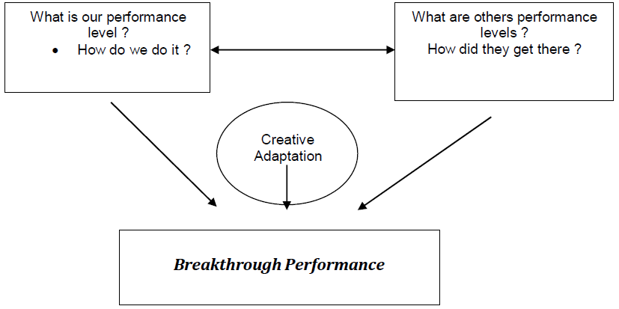
BENCHMARKING
BENCHMARKING CONCEPT
Dr. Karamjeet Kaur AOE0861 TQM Unit 3

Slide 95
BENCHMARKING
REASONS TO BENCHMARK :
➢ It is a tool to achieve business and competitive objectives
➢ It can inspire managers (and Organizations) to compete
➢ It is time and cost effective
➢ It constantly scans the external environment to improve the
process
➢ Potential and useful technological breakthroughs can be located
and adopted early
Dr. Karamjeet Kaur AOE0861 TQM Unit 3

Slide 96
BENCHMARKING
PROCESS OF BENCHMARKING
The following six steps contain the core techniques of Benchmarking
1. Decide what to benchmark
➢ Benchmarking can be applied to any business or production process
➢ The strategy is usually expressed in terms of mission and vision statements
➢ Best to begin with the mission and critical factors
➢ Choosing the scope of the Benchmarking study
➢ Pareto analysis – what process to investigate
➢ Cause and Effect diagram – for tracing outputs back
Dr. Karamjeet Kaur AOE0861 TQM Unit 3

Slide 97
BENCHMARKING
2. Understand current performance
Creative
Adaptation
What is our performance level ?
How do we do it ?
What are others performance levels ?
How did they get there ?
Breakthrough Performance
➢ Understand and document the current process
➢ Those working in the process are the most capable of identifying and
correcting problems
➢ While documenting, it is important to quantify
➢ Care should be taken during accounting information
Dr. Karamjeet Kaur AOE0861 TQM Unit 3

Slide 98
BENCHMARKING
3. Plan
➢ A benchmarking team should be chosen
➢ Organizations to serve as the benchmark need to be identified
➢ Time frame should be agreed upon for each of the benchmarking tasks
There are three types of benchmarking
a. Internal
b. Competitive
c. Process
Dr. Karamjeet Kaur AOE0861 TQM Unit 3

Slide 99
BENCHMARKING
4. Study Others
Benchmarking studies look for two types of information
➢ How best the processes are practiced
➢ Measurable results of these practices
Three techniques for conducting the research are
➢ Questionnaires
➢ Site visits
➢ Focus groups
Dr. Karamjeet Kaur AOE0861 TQM Unit 3

Slide 100
BENCHMARKING
5. Learn from the data
Answering a series of questions like
➢ Is there a gap between the organization’s performance and the
performance of the best-in-class organizations?
➢ What is the gap? How much is it?
➢ Why is there a gap? What does the best-in-class do differently that is
better?
➢ If best-in-class practices were adopted, what would be the resulting
improvement?
Benchmarking studies can reveal three different outcomes
➢ Negative gap
➢ Parity
➢ Positive gap
Dr. Karamjeet Kaur AOE0861 TQM Unit 3

Slide 101
BENCHMARKING
6. Using the findings
The objective is to close the gap. For this
➢ Findings must be communicated to the people within the organization
➢ Action plans must be developed to implement new processes
Groups that must agree on the change
➢ Process owners
➢ Upper management
Dr. Karamjeet Kaur AOE0861 TQM Unit 3

Slide 102
BENCHMARKING
Steps for the development and execution of action plans are:
1. Specify tasks
2. Sequence tasks
3. Determine resources needs
4. Establish task schedule
5. Assign responsibility for each task
6. Describe expected results
7. Specify methods for monitoring results
Dr. Karamjeet Kaur AOE0861 TQM Unit 3

Slide 103
BENCHMARKING
PITFALLS AND CRITICISMS OF BENCHMARKING :
➢ Idea of copying others
➢ It is not a cure or a business philosophy
➢ Some process have to be benchmarked repeatedly
➢ It is not a substitute for innovation
Dr. Karamjeet Kaur AOE0861 TQM Unit 3

Slide 104
FACULTY VIDEO LINKS, YOUTUBE & NPTEL VIDEO LINKS AND ONLINE COURSES DETAILS
https://www.youtube.com/watch?v=Q3EOCAuExJU
https://www.youtube.com/watch?v=yWlAOFs04go
https://www.youtube.com/watch?v=QifqIoUNTJM
https://www.youtube.com/watch?v=qb3mvJ1gb9g
https://www.youtube.com/watch?v=2ePeXePNLrs
https://www.youtube.com/watch?v=HkdoR-NNEoI
https://www.researchgate.net/publication/318654507_Total_Quality_Management_Notes
http://www.mescenter.ru/images/abook_file/Total_Quality_Management_and_Six_Sigma.pdf

Slide 105
DAILY QUIZ
What is histogram?
Briefly explain pareto chart?
Explain the check sheet?
Give the example of control chart?
What is use of control chart?

Slide 106
WEEKLY ASSIGNMENT
1. Discuss Pareto Charts.
2. Discuss fishbone diagrams.
3. Discuss Histogram.
4. Discuss control charts for variables.
5. Discuss flowcharts and give a simple example.
6. Provide an overview of the Toyota practical problem solving process.
7. Explain a total quality decision making process.
8. Explain why quality tools are important.

Slide 107
MCQs
Fish bone diagram is also known as? a. Cause and effect chart
b. Ishikawa diagram
c. Both a and b
d. None of the above
Control chart is a
Process monitoring tool
Process control tool
Both (a) and (b)
d) None of the above

Slide 108
MCQs
Rectangle represents ________ While plotting flow chart.
Step in activity
Decision making
Direction of flow
d. None of the above
__________ is used to collect data
a. Check sheets
b. Histogram
c. Scatter diagram
d. Control chart

Slide 109
MCQs
__________represent the data graphically
a. Check sheets
b. Histogram
c. Scatter diagram
d. Control chart
__________ shows the relationship between two variables
a. Check sheets
b. Histogram
c. Scatter diagram
d. Control chart

Slide 110
MCQs
__________ explains if process under control or not
a. Check sheets
b. Histogram
c. Scatter diagram
d. Control chart
___________helps in identifying the main cause of problem
a. Histogram
b. Pareto chart
c. cause and effect diagram
d. Flow chart

Slide 111
MCQs
Which identify the root cause of problem and their effect
a. Histogram
b. Pareto chart
c. cause and effect diagram
d. Flow chart
Which is used to represent graphically different process and work flow
a. Histogram
b. Pareto chart
c. cause and effect diagram
d. Flow chart

Slide 112
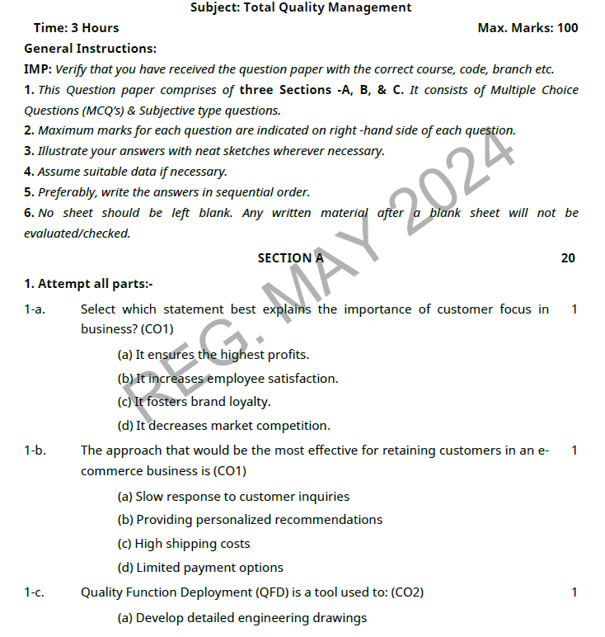
OLD QUESTION PAPERS

Slide 113
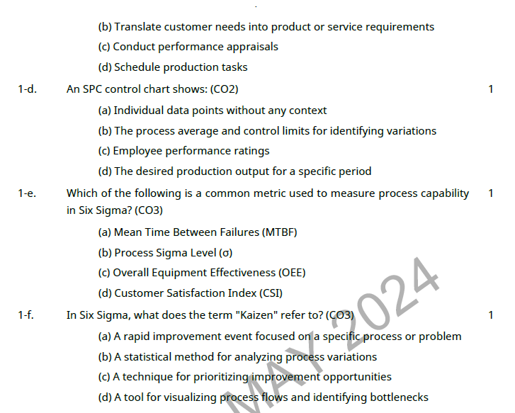
OLD QUESTION PAPERS

Slide 114
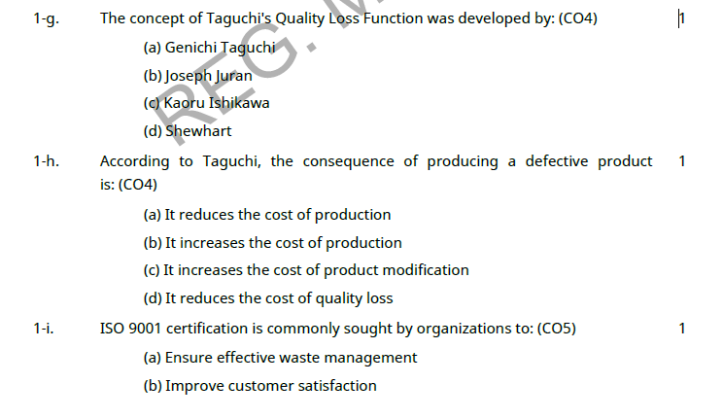
OLD QUESTION PAPERS

Slide 115
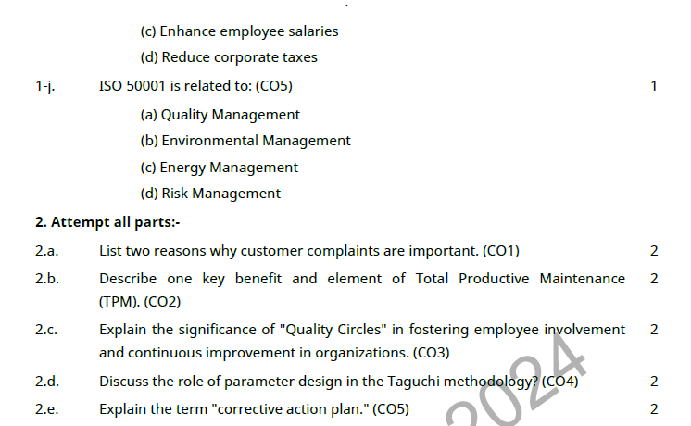
OLD QUESTION PAPERS

Slide 116
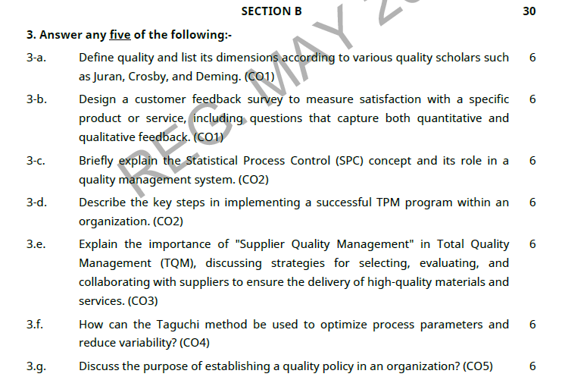
OLD QUESTION PAPERS

Slide 117
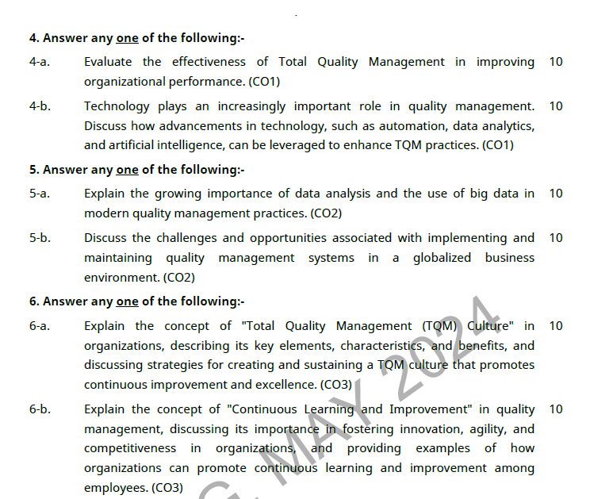
OLD QUESTION PAPERS

Slide 118
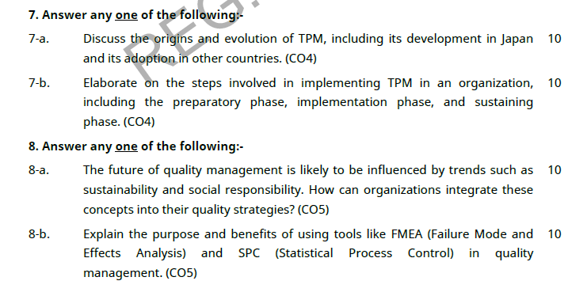
OLD QUESTION PAPERS

Slide 119
EXPECTED QUESTIONS FOR UNIVERSITY EXAM
Explain the concepts of Six Sigma?
Explain any four tools of quality control?
What are the new seven management tools?
List out the types of cause and effect diagram?
What is a measure of central tendency?
What is the use of the control chart?

Slide 120
SUMMARY
Each of these quality tools has unique advantages for certain situations. And, not all tools are used for all problem-solving.
Once a tool is learned, it can be adapted to different problem-solving opportunities.
Additionally, as with anything else, using tools properly takes practice and experience. Simply start using each of the tools, and over time, you will become proficient and a great problem solver!
What problems does your organization have that could benefit from one of these tools?

Slide 121
SUMMARY
The seven basic tools of quality is a designation given to a fixed set of graphical techniques identified as being most helpful in troubleshooting issues related to quality. They are called basic because they are suitable for people with little formal training in statistics and because they can be used to solve the vast majority of quality-related issues

Slide 122
REFERENCES
Text Book
Lt. Gen. H. Lal, “Total Quality Management”, Eastern Limited
Greg Bounds, “Beyond Total Quality Management”, McGraw Hill
Menon, H.G, “TQM in New Product manufacturing”, McGraw Hill
Reference Book
Total Quality Management” by Besterfield
“Total Quality Management” by Mukherjee
Total Quality Management” by Vijayan
“Total Quality Management- Text and Cases” by Janakiraman B and Gopal R K
https://www.researchgate.net/publication/318654507_Total_Quality_Management_Notes

Slide 123
Thank You

